Slide 1

Serotonin Receptor activity affects maternal behavior
Avery Del Grosso – March 2020

Slide 2
Theme
5HT_{2A} receptor stimulation & subsequent internalization disrupts maternal behavior.
  We will look at how a few neurotransmitters act on 5-HT_{2A} receptors, their role in maternal behavior, and the internalization of 5-HT_{2A} receptors.

Slide 3
Characters
5-HT_{2A} receptors
TCB-2
Pimavanserin
Postpartum maternal behavior

Slide 4
Hypotheses
Maternal postpartum depression is linked to 5-HT_{2A} receptor activation.
Activation of 5-HT_{2A} receptors in the prefrontal cortex impair maternal behavior via an altered decision-making state.
5-HT_{2A} receptor internalization causes paradoxical effects between agonists and inverse agonists.

Slide 5
What don’t we know?
What exactly is maternal behavior?
  What does it look like?
What is the connection between maternal behavior and serotonin receptors?
What is TCB-2 & Pimavanserin?

Slide 6

Postpartum Mental Disorders
According to WHO:
13% of women who just gave birth experience a mental disorder
    Depression
      Suicide
    Psychosis

Slide 7

Postpartum Depression Impacts Parenting
Compromised caregiving activities
  Feeding
  Sleep routines
  Well-child visits
  Vaccinations
  General safety practices

Slide 8



Rat Maternal Behaviors
Pup retrieval (back to nest)
Hovering over pup
Pup licking
Nest building

Slide 9
5HT_{2A} & Rat Maternal Behavior
5HT_{2A} receptor & sex hormones
  Interact reciprocally
Olfaction is important
    5HT_{2A} in olfactory processing regions
    e.g. piriform & enthorinal cortex, etc.

Slide 10
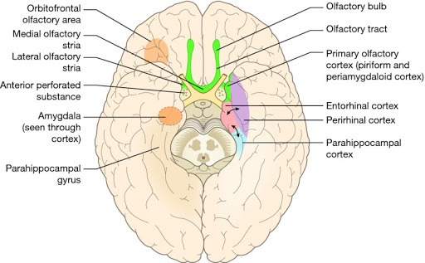
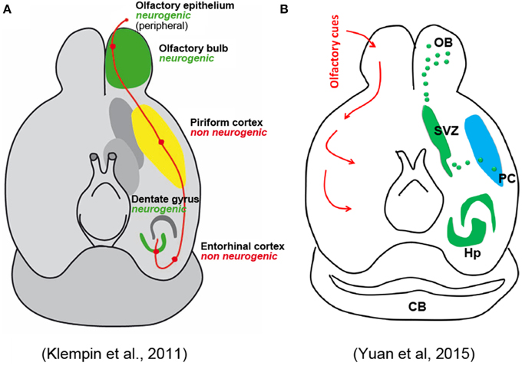

Slide 11
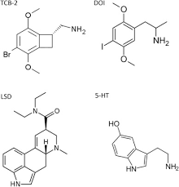
TCB-2
High affinity 5HT_{2A} agonist
  Serotonergic Psychadelic
No other receptors interact
  e.g. D₂ receptors

Slide 12
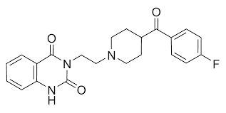
Ketanserin
5HT_{2A} neutral antagonist
  Binds equally to active and inactive GPCR states

Slide 13
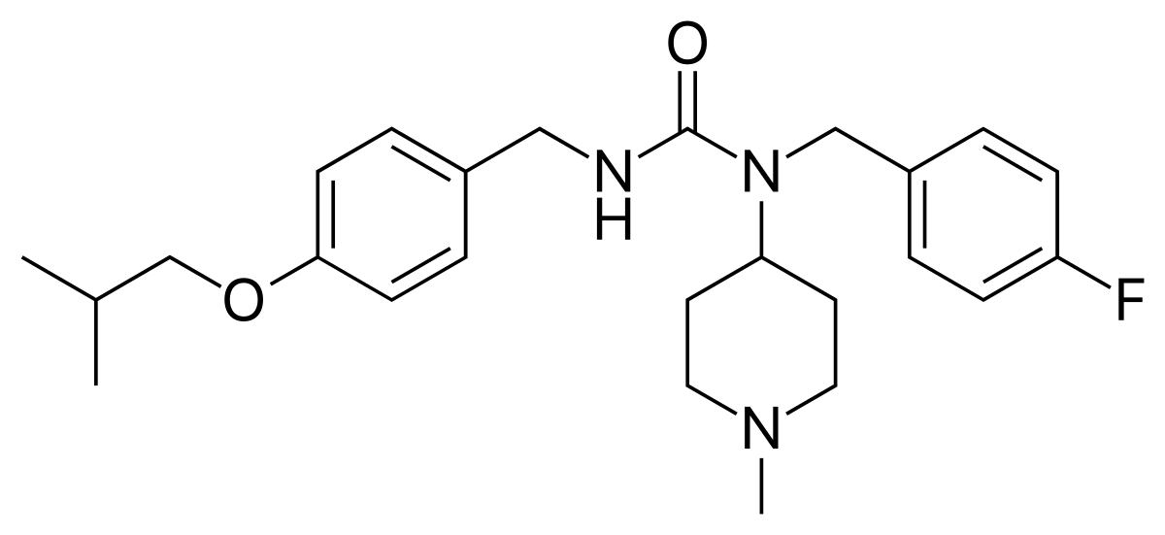
Pimavanserin
Selective 5HT_{2A} inverse agonist
Does not bind to D₂ receptors

Slide 14
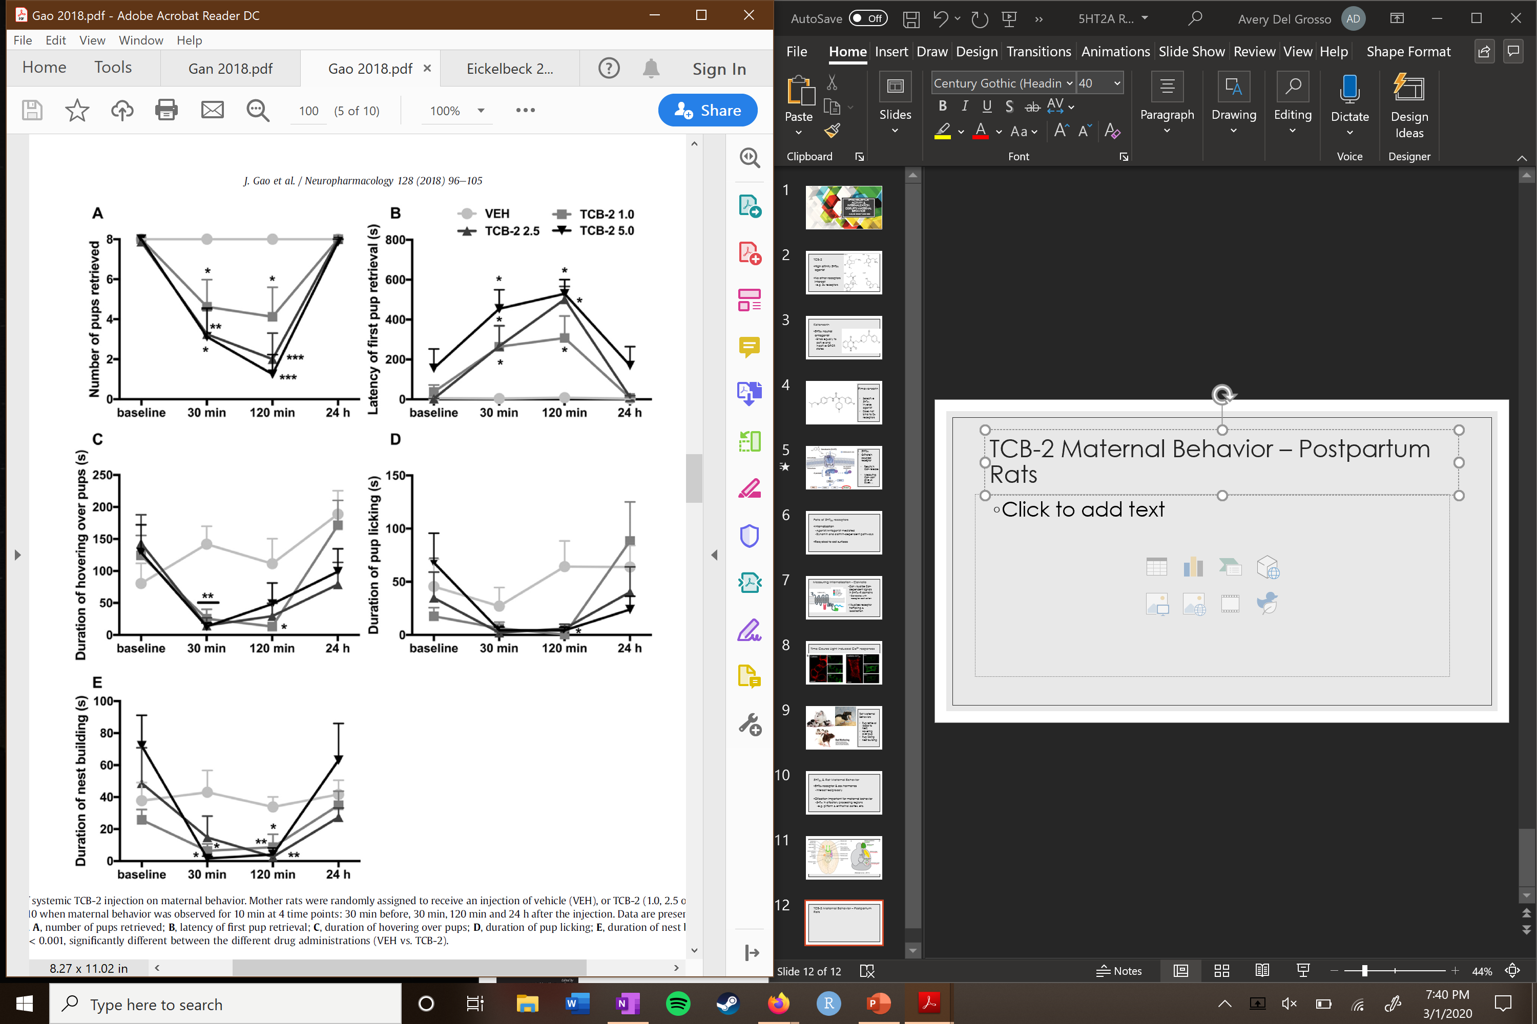
Postpartum Rat Maternal Behavior (Intraperitoneal injections)
TCB-2

Slide 15
Postpartum Rat Maternal Behavior (Intraperitoneal injections)
TCB-2
Expected results
Large effect
No effect

Slide 16
Postpartum Rat Maternal Behavior (Intraperitoneal injections)
TCB-2

Slide 17
Postpartum Rat Maternal Behavior (Intraperitoneal injections)
TCB-2
TCB-2
Large effect
No effect

Slide 18
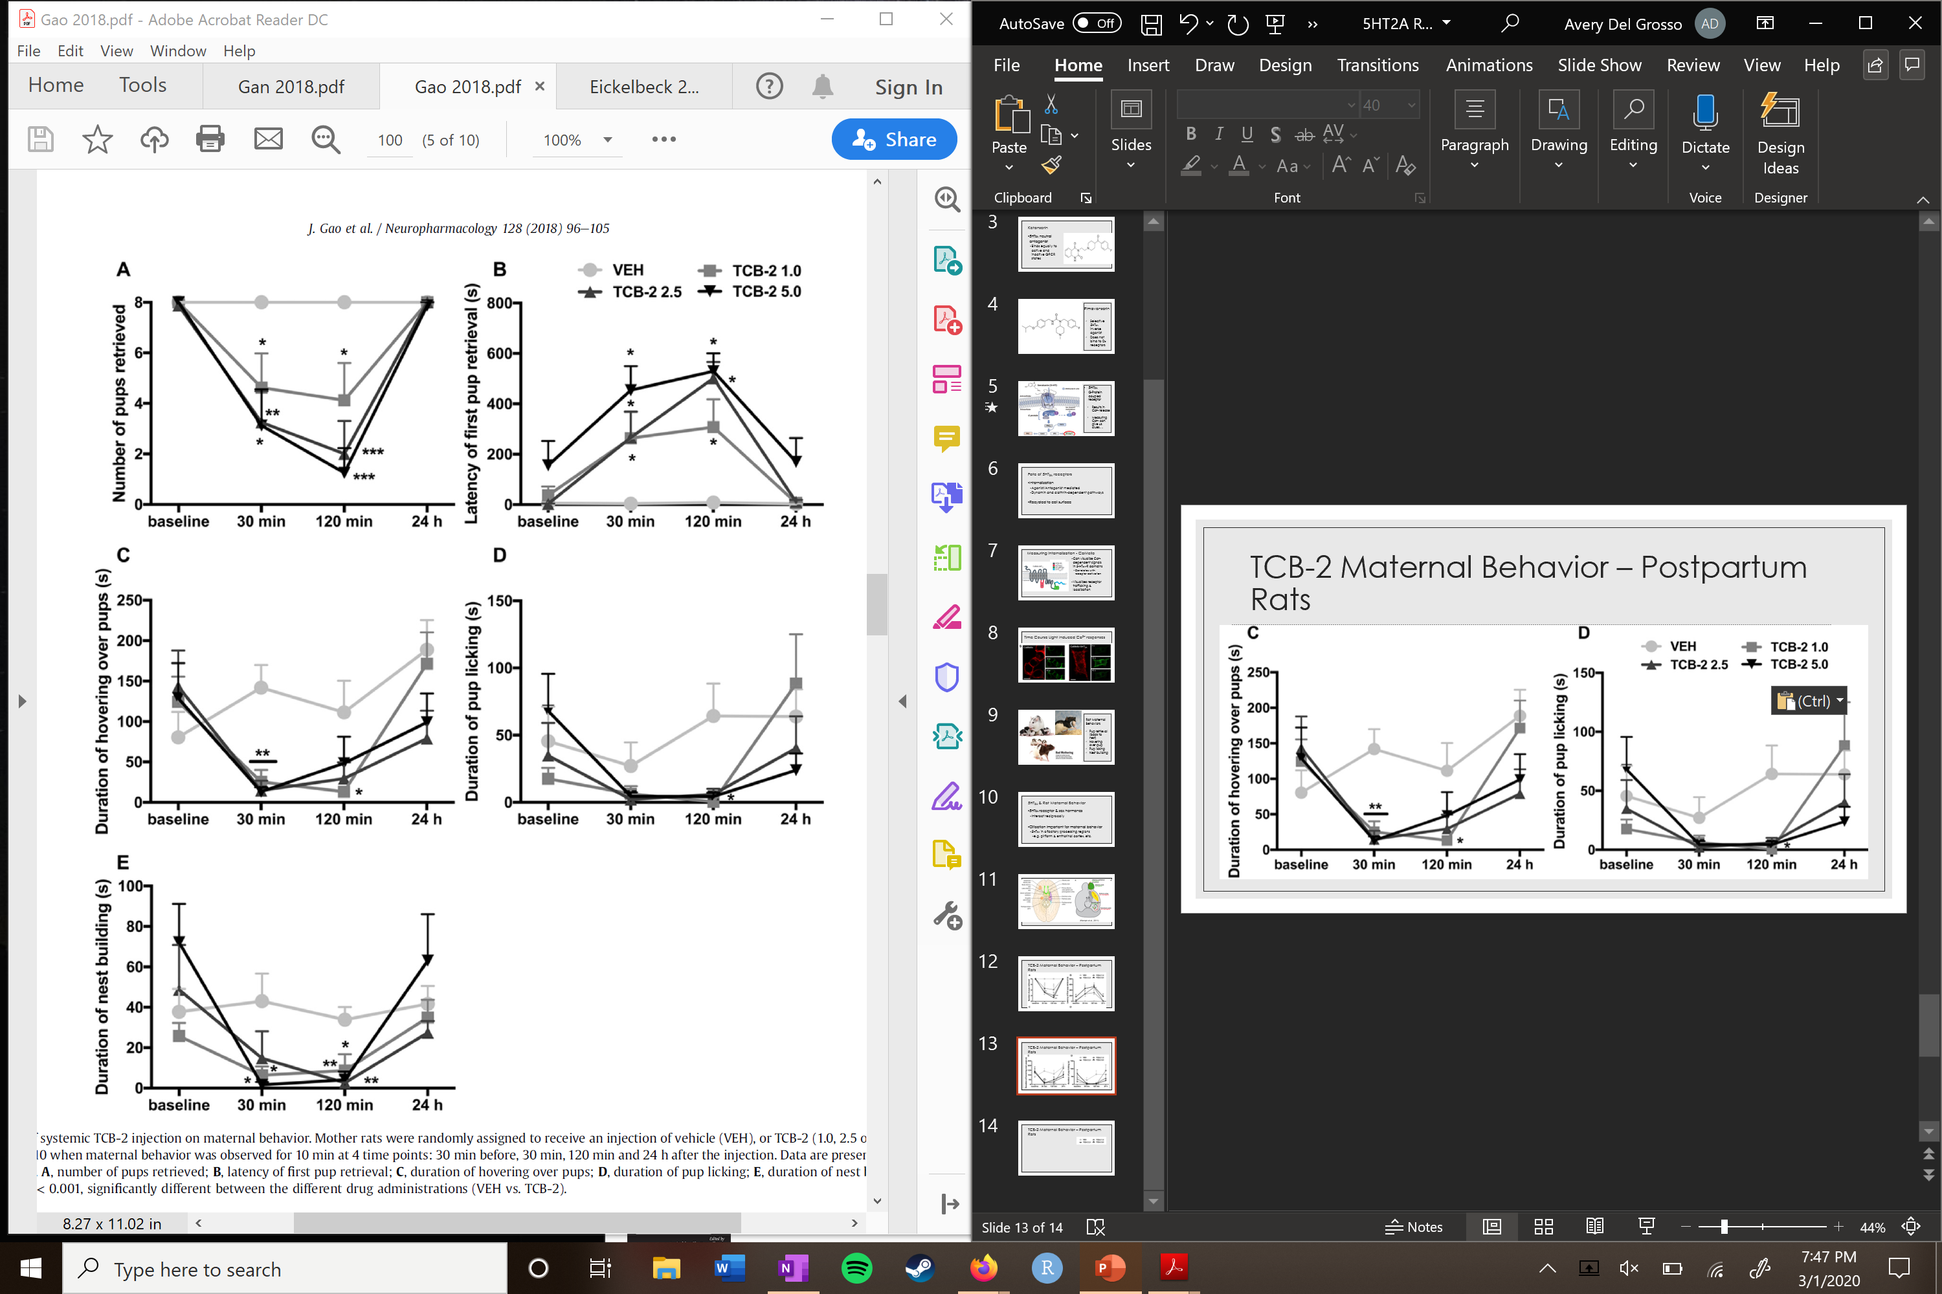
Postpartum Rat Maternal Behavior (Intraperitoneal injections)
TCB-2

Slide 19

Postpartum Rat Maternal Behavior (Intraperitoneal injections)
TCB-2
Unexpected
Results
Large effect
Large effect

Slide 20
Postpartum Rat Maternal Behavior (Intraperitoneal injections)

Slide 21
Postpartum Rat Maternal Behavior (Intraperitoneal injections)
No effect
Large effect

Slide 22
TCB-2 Microinjections – Medial Prefrontal Cortex
Notes:
Numbers to the left of the sections indicate anteroposterior distance from bregma in millimeters

Slide 23
TCB-2 Microinjections – Medial Prefrontal Cortex
Notes:
Numbers to the left of the sections indicate anteroposterior distance from bregma in millimeters

Slide 24
Graph summary:
TCB-2 (agonist)
Ketanserin (antagonist)
Pimavanserin (inv. agonist)
Impaired Maternal Behavior
Little/no effect
Impaired Maternal Behavior

Slide 25

Graph summary:
Paradoxical?
TCB-2 (agonist)
Ketanserin (antagonist)
Pimavanserin (inv. agonist)
Impaired Maternal Behavior
Little/no effect
Impaired Maternal Behavior

Slide 26
Paradoxical Outcome
Inverse agonists (Pimavanserin)
  Pharmacologically opposite to agonists
  So, why do both impair maternal behavior?
Suggests 5-HT_{2A} regulation is key
Dysfunction negatively affects maternal behavior
  “overactivation” or “underactivation”

Slide 27
Hypotheses
Maternal postpartum depression is linked to 5-HT_{2A} receptor activation.
Activation of 5-HT_{2A} receptors in the prefrontal cortex impair maternal behavior via an altered decision-making state.
5-HT_{2A} receptor internalization causes paradoxical effects between agonists and inverse agonists.

Slide 28
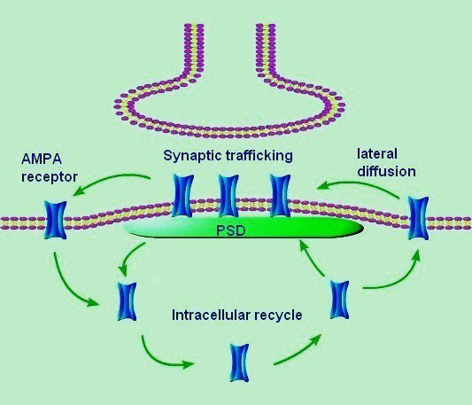
Receptor Trafficking
Note: these are not 5-HT_{2A} receptors
5HT_{2A} receptors trafficked differently than “conventional” neurons
  May provide an explanation to the agonist/inverse agonist issue…

Slide 29
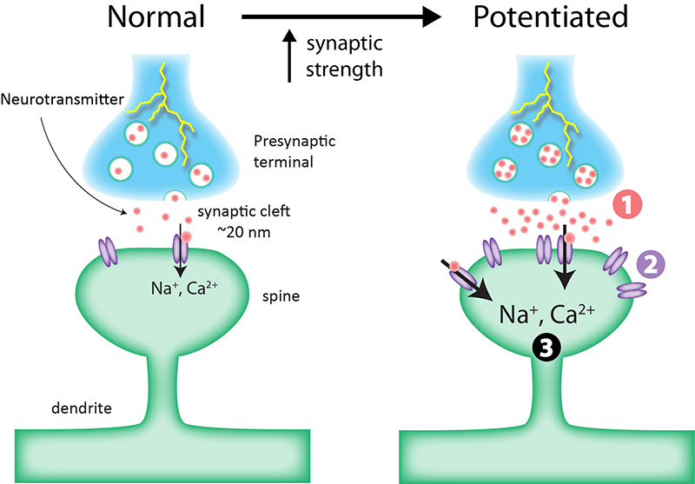
“Conventional” neuron
Activation recruits more postsynaptic receptors
Signal strength increases

Slide 30
Fate of 5HT_{2A} receptors
Internalization
  Agonist/Antagonist mediated
  Dynamin and clathrin-dependent pathways
  Internalized within neuron to target
Recycled to cell surface

Slide 31
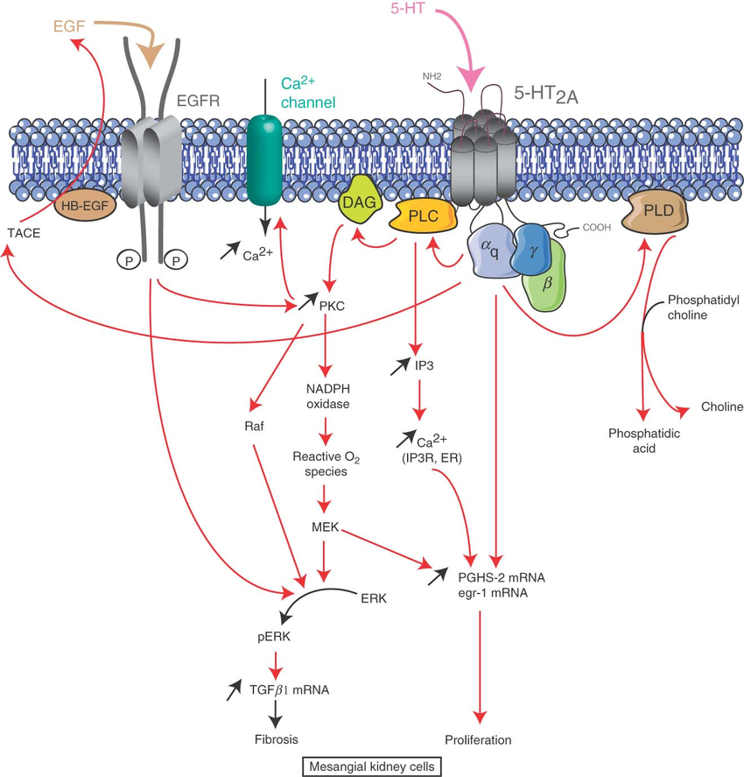
5HT_{2A}
G-Protein coupled receptor
  Results in Ca²⁺ release
  Measuring Ca²⁺ can give us clues….

Slide 32
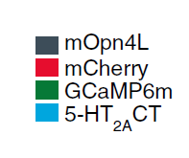
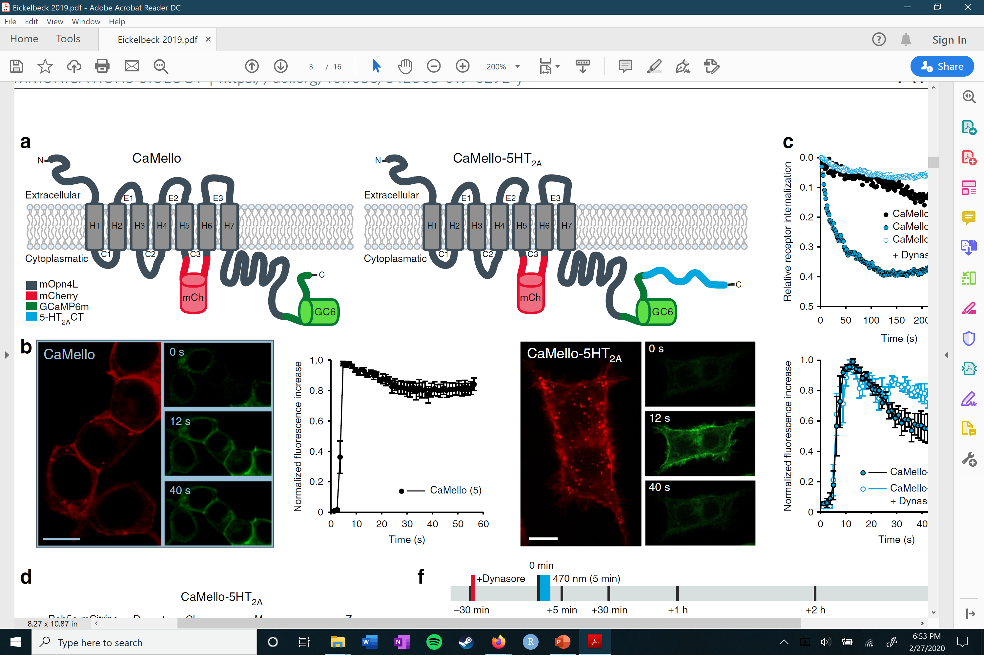
Measuring internalization - CaMello
  Can visualize Ca²⁺ dependent signals in 5-HT_{2A}-R domains
    Correlates with receptor activation
  Visualizes receptor trafficking & localization

Slide 33
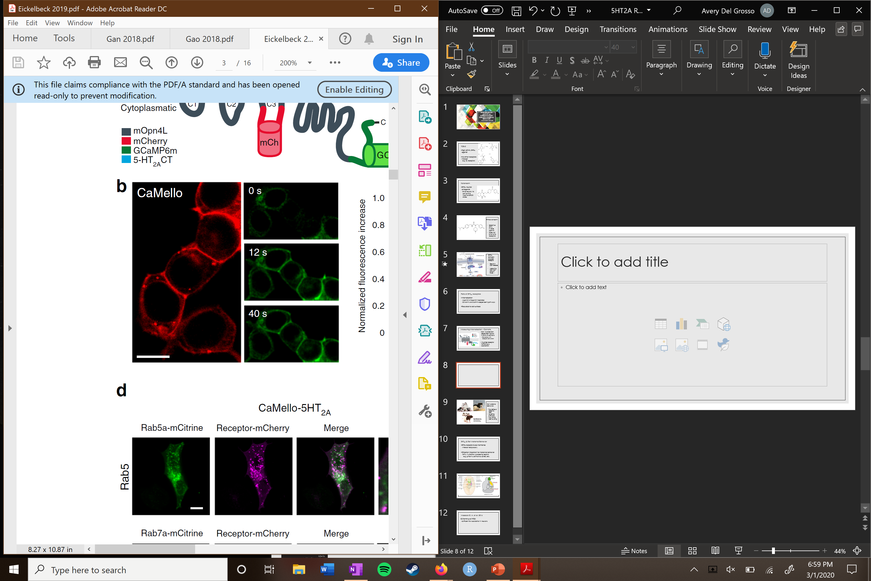
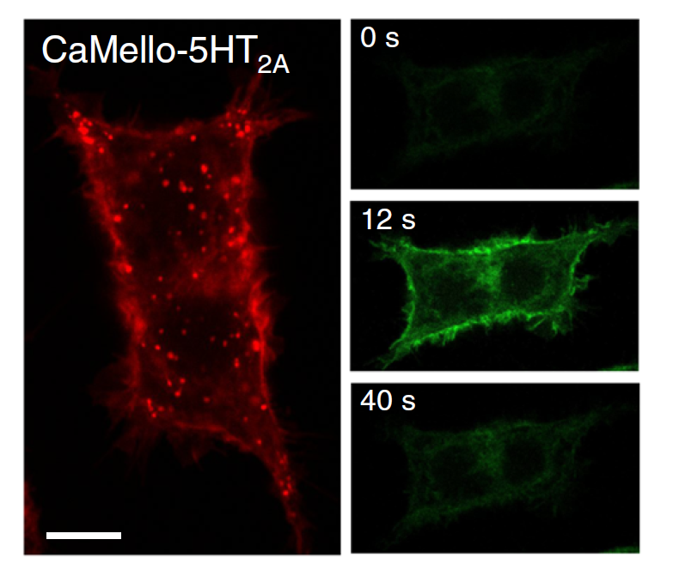
Time Course Light Induced Ca²⁺ responses

Slide 34
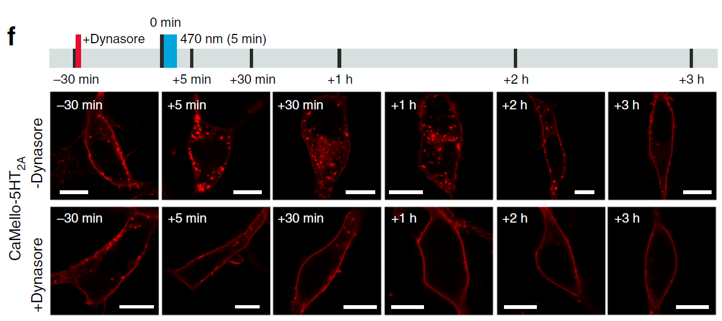
Dynesore = Dynamin inhibitor

Slide 35
Trafficking Theory
5-HT_{2A} trafficking may explain paradoxical maternal behavior
  Unclear exactly how
  internalized receptors/ Recycling -> Desensitization?
    TCB-2
  internalized receptors/ Recycling -> Oversensitization?
    Pimavanserin

Slide 36
Conclusions
5-HT_{2A} receptor is key in maternal behavior
  Rats & (Probably) Humans
Activation of 5-HT_{2A} receptors in the prefrontal cortex impairs maternal behavior
Delicate balance in receptor activation everywhere
  Too much/too little = impaired maternal behavior
  Can we develop supplementary ways of regulating 5-HT_{2A} activation?
  How can we use this information to better treat postpartum mental diseases?

